Slide 1

Customer Shopping Behavior Analysis
This project analyzes customer shopping behavior using transactional data from 3,900 purchases across various product categories. Our goal is to uncover insights into spending patterns, customer segments, product preferences, and subscription behavior to guide strategic business decisions.

Slide 2

Project Overview
1
2
Data Analysis
Key Insights
Analyzed 3,900 customer purchases.
Uncovered spending patterns and product preferences.
3
Strategic Decisions
Aimed at guiding business strategies.

Slide 3

Dataset Summary
Our dataset comprises 3,900 rows and 18 columns, detailing customer demographics, purchase specifics, and shopping behaviors.
Rows: 3,900
Columns: 18
Missing Data: 37 values in Review Rating
Customer Demographics
Purchase Details
Shopping Behavior
Age, Gender, Location, Subscription Status
Item, Category, Amount, Season, Size, Color
Discount, Promo Code, Previous Purchases, Frequency, Review, Shipping

Slide 4
Exploratory Data Analysis (EDA) in Python
01
02
03
Data Loading & Exploration
Missing Data Handling
Column Standardization
Imported dataset with pandas, checked structure and summary statistics.
Imputed missing 'Review Rating' values using median per product category.
Renamed columns to 'snake_case' for readability.
04
05
Feature Engineering
Database Integration
Created 'age_group' and 'purchase_frequency_days' columns.
Loaded cleaned data into PostgreSQL for SQL analysis.

Slide 5

Data Analysis using SQL: Key Business Insights
Revenue by Gender
Top 5 Products by Rating
Female: $75,191, Male: $157,890
Gloves (3.86), Sandals (3.84), Boots (3.82), Hat (3.80), Skirt (3.78)
Shipping Type Comparison
Standard: $58.46, Express: $60.48

Slide 6


SQL Insights: Discounts & Subscriptions
High-Spending Discount Users
Subscribers vs. Non-Subscribers
Identified 839 customers who used discounts but spent above average.
Subscribers (1053): Avg Spend $59.49, Total Revenue $62,645
Non-Subscribers (2847): Avg Spend $59.87, Total Revenue $170,436

Slide 7
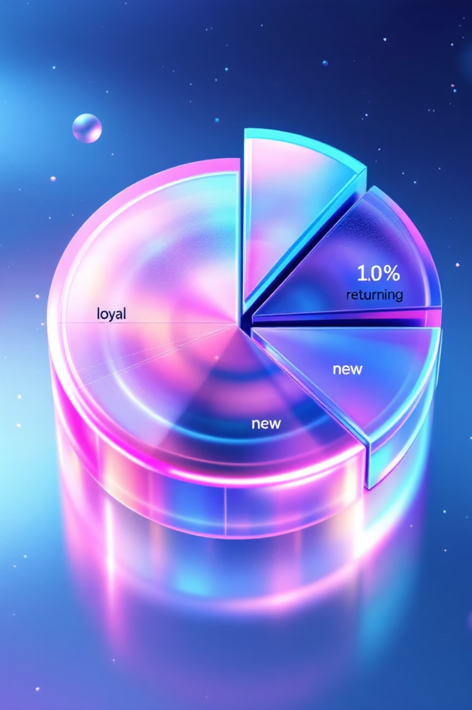
SQL Insights: Product & Customer Segmentation
Discount-Dependent Products
1
Hat (50%), Sneakers (49.66%), Coat (49.07%), Sweater (48.17%), Pants (47.37%)
Customer Segmentation
2
Loyal (3116), Returning (701), New (83)

Slide 8


SQL Insights: Top Products & Age Groups
Top 3 Products per Category
Revenue by Age Group
Accessories: Jewelry, Sunglasses, Belt
Young Adult: $62,143
Clothing: Blouse, Pants, Shirt
Middle-aged: $59,197
Footwear: Sandals, Shoes, Sneakers
Adult: $55,978
Outerwear: Jacket, Coat
Senior: $55,763

Slide 9
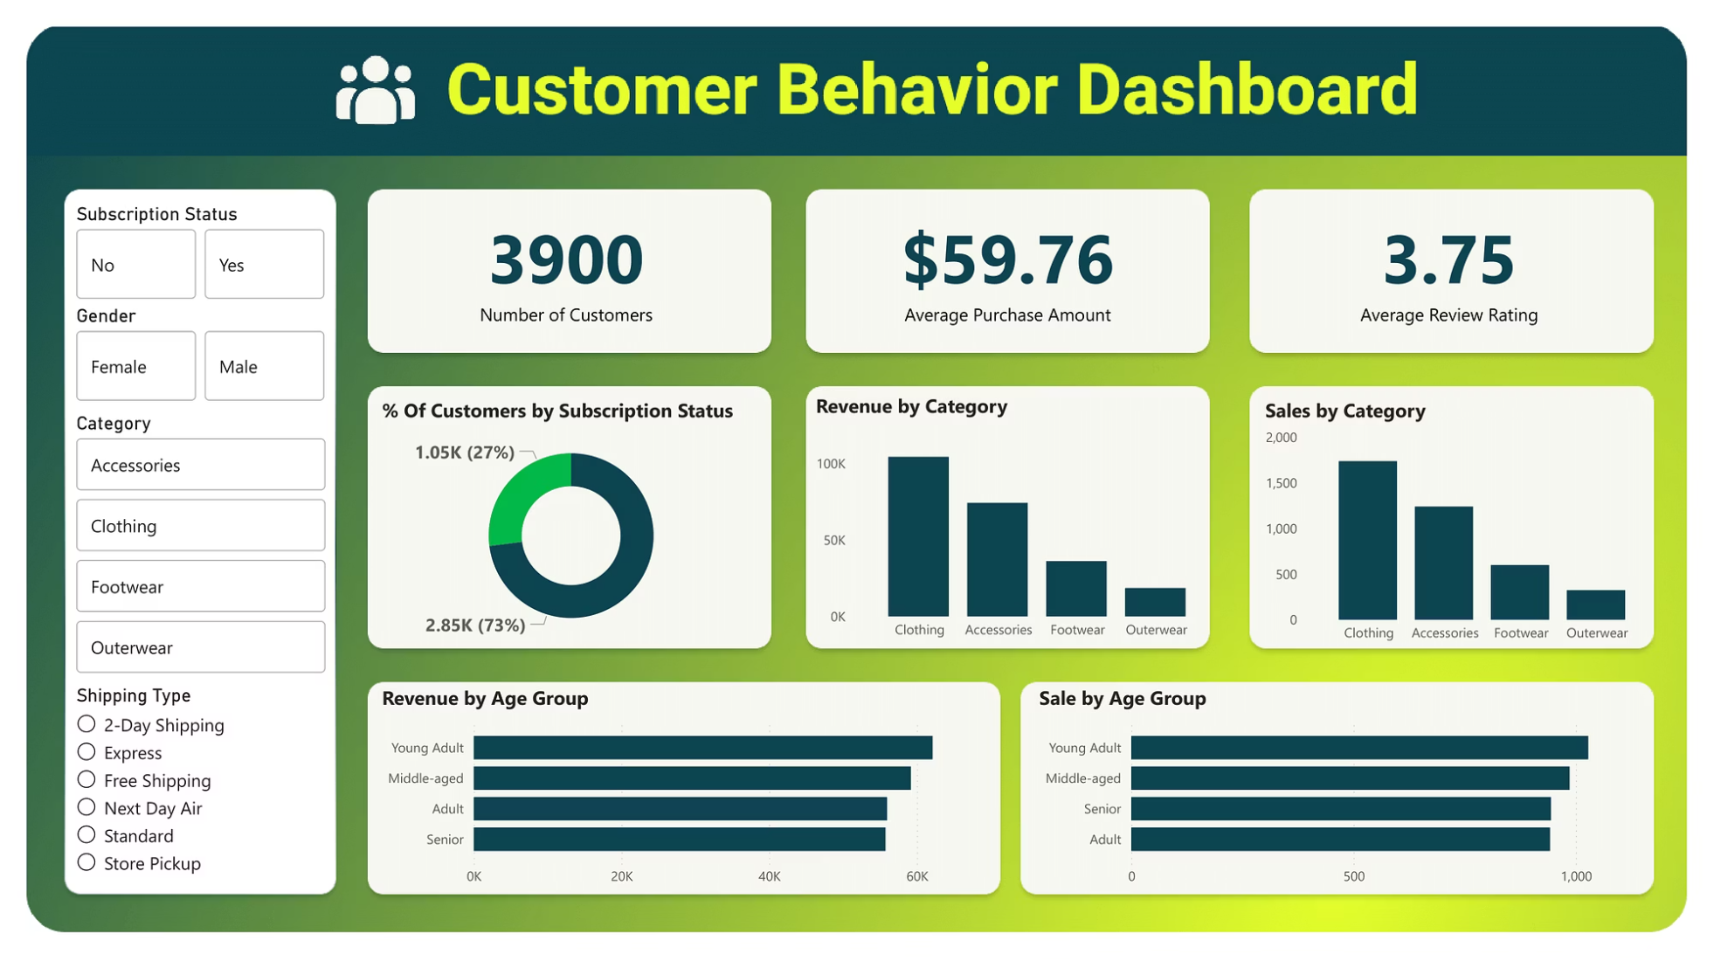
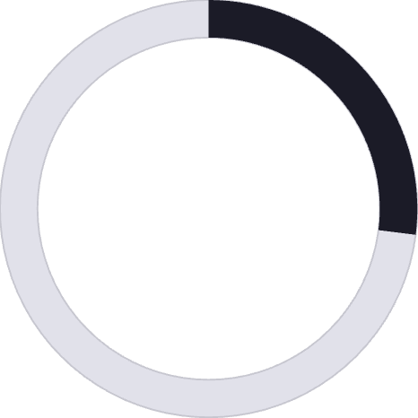

Dashboard in Power BI
An interactive dashboard in Power BI visually presents key insights, including customer count (3.9K), average purchase amount ($59.76), and average review rating (3.75).
27%
73%
Subscribers
Non-Subscribers

Slide 10

Business Recommendations
Boost Subscriptions
Promote exclusive benefits to increase subscriber base.
Customer Loyalty Programs
Reward repeat buyers to foster loyalty and move them into the “Loyal” segment.
Review Discount Policy
Balance sales boosts with margin control for sustainable growth.
Product Positioning
Highlight top-rated and best-selling products in marketing campaigns.
Targeted Marketing
Focus efforts on high-revenue age groups and express-shipping users for maximum impact.

